Slide 1
GAHEC WORKSHOP:
JAX for astrophysicists
S. Dupourqué, F. Sarron

Slide 2
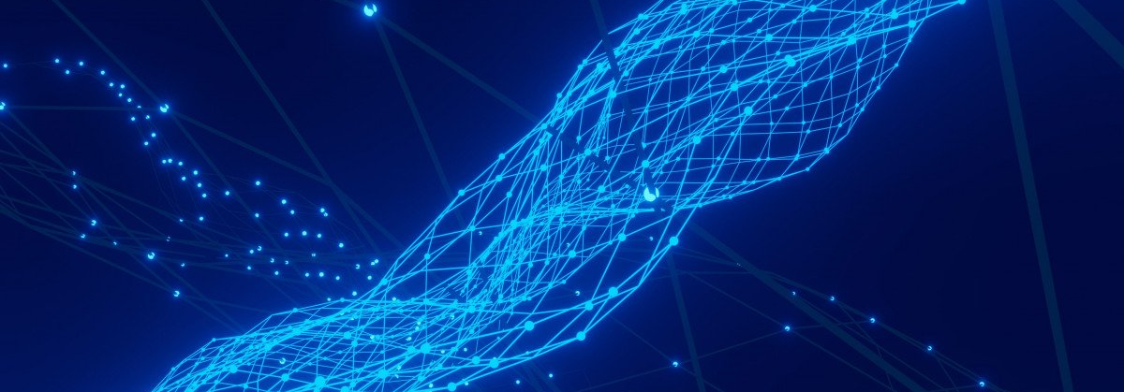
01
Neural networks

Slide 3
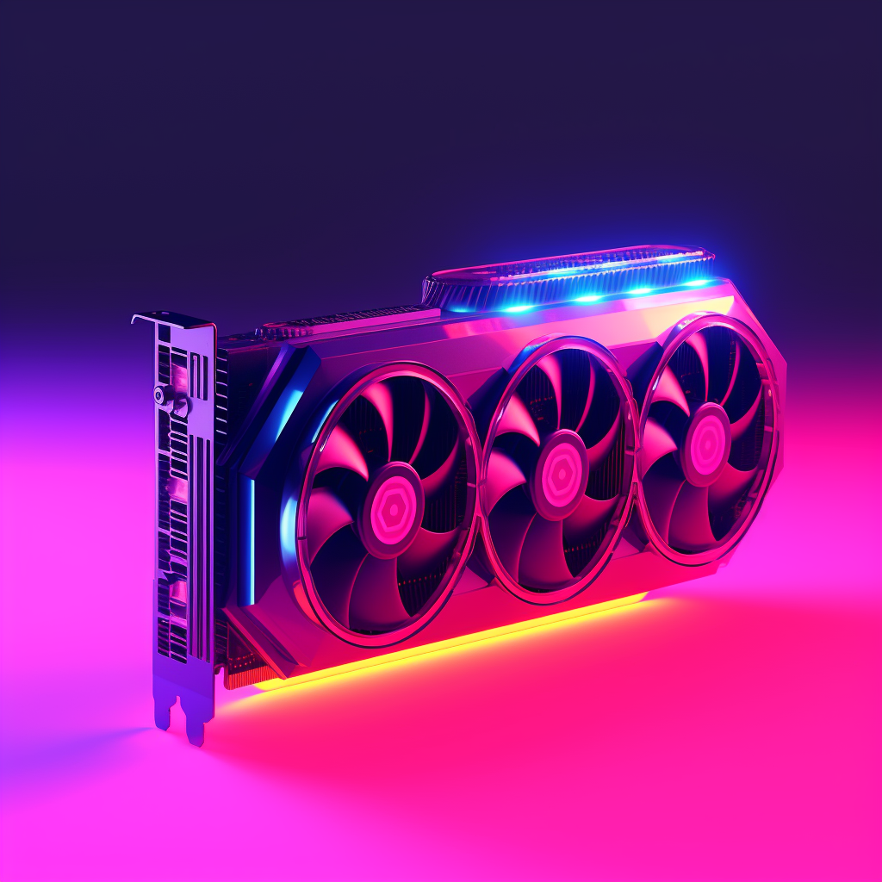
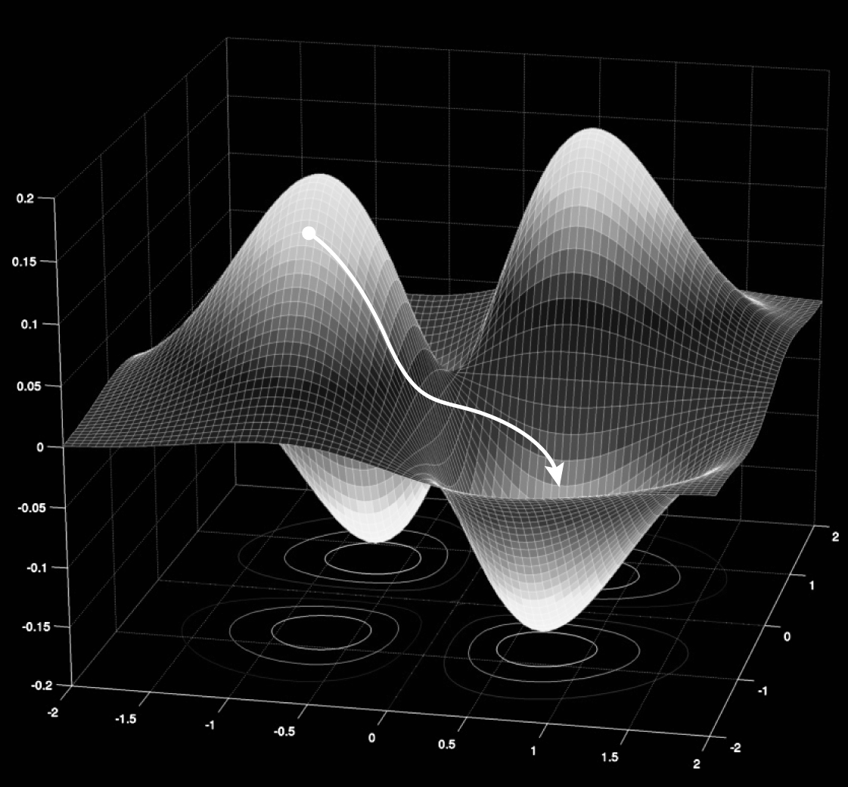


How can we train NN with +10⁹ parameters ?
GPUs
Differentiability

Slide 4
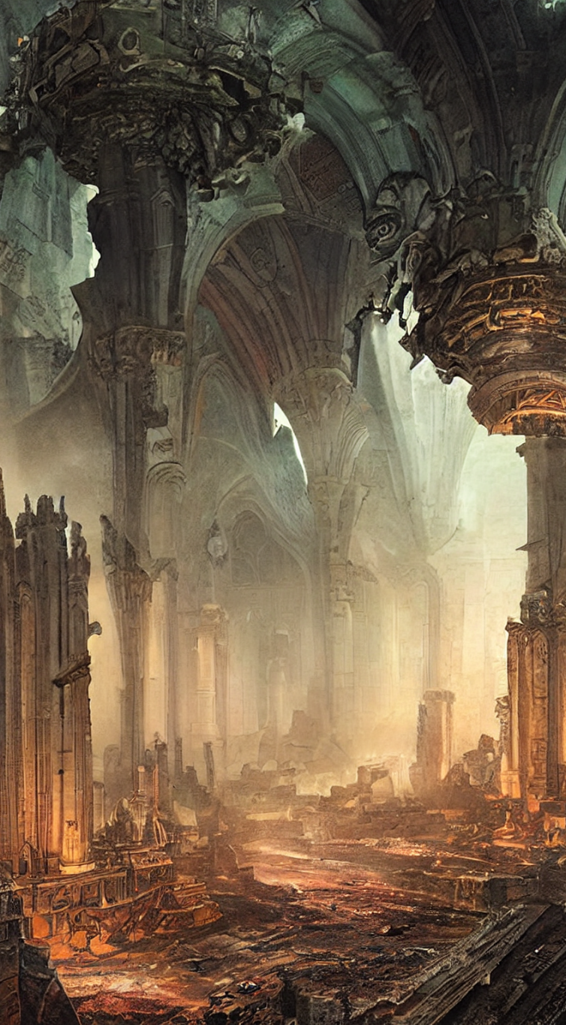
2
What is JAX?

Slide 5


Compilable and differentiable Python code?
Same code running on CPU, GPU, and even TPU?
All of this at once!
NumPy on steroids?
Python open-source ecosystem?

Slide 6
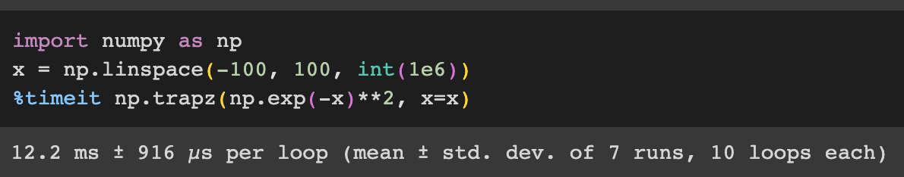

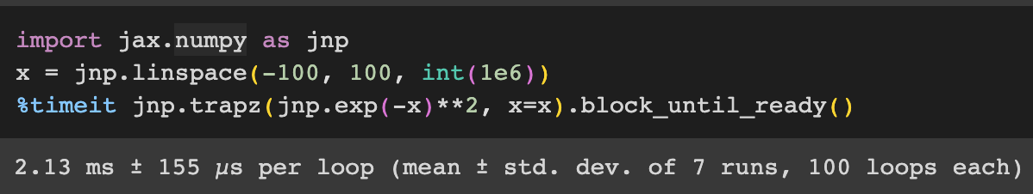
How to start with it
it?
Use jnp instead of np
x6 speedup in this case

Slide 7
Major functionalities
(1) Differentiable with grad()
(2) Compilable with jit()
(3) Vectorizable with vmap()

Slide 8
A growing ecosystem (~3 years old max)
Even astrophysics!
jax-cosmo
PZFlow
JaxPM
jaxspec
Bayesian inference
Gradient descent
PyMC
Numpyro
JAXopt
Optax
JAXFit
JAX is used and actively contributed by the following :
Google
Deepmind
UberAI
Midjourney
Machine learning
Normalizing flows
Flax
Haiku
Equinox
And many scientists and other companies!
jax-flows
NUX

Slide 9
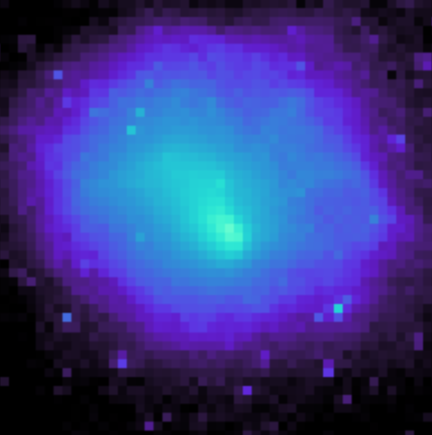
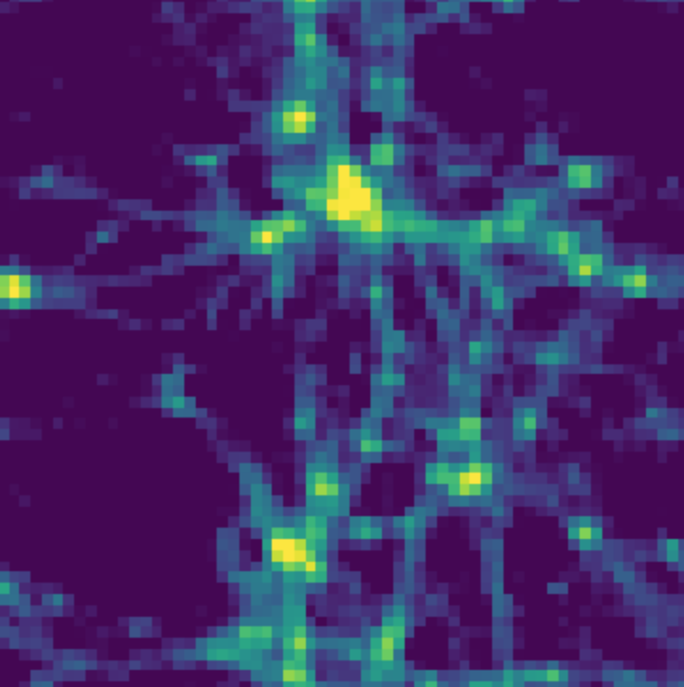
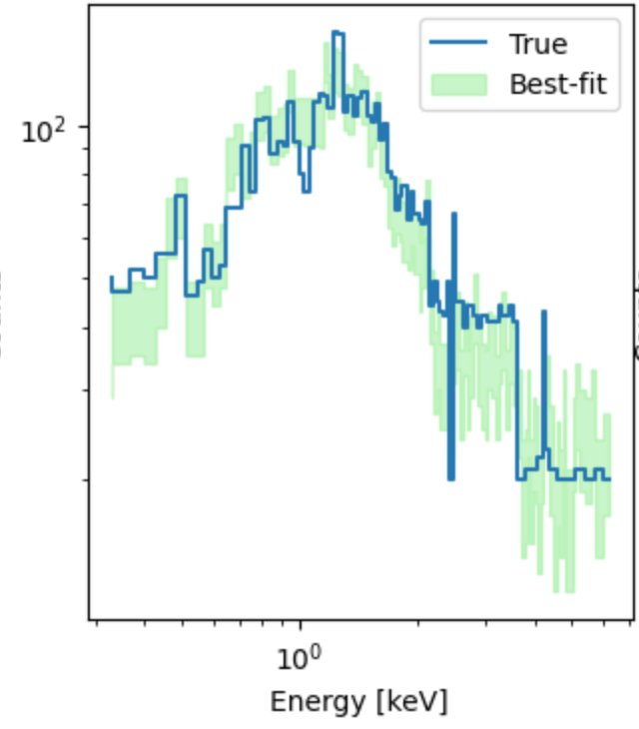
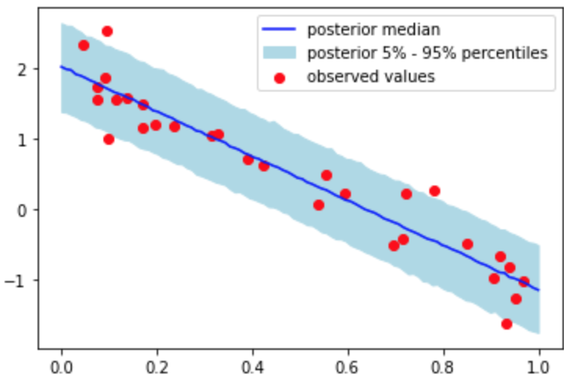
Planning of the workshop
100 exercises :
https://github.com/vopani/jaxton
Fit a surface brightness model
Introduction notebook
MCMC Tutorial
N-body sim
Spectral fit
Useful links :
https://jax.readthedocs.io/en/latest/jax.html
https://www.kaggle.com/code/goktugguvercin/introduction-to-jax

